Slide 1
Please Read
Background art, fonts, and the color palette have been formatted for you in the Slide Master.
The font for this presentation is Arial. Please use only this font, or its Mac equivalent.
Line-spacing for bullets has been set for you. There should not be a need to add an extra “carriage return” (Enter key) between bullets.
Read the “Helpful Hints” provided in the Notes Page (in the “View” menu) of this slide.
Notes:
Helpful hints:
Please do not begin your presentation with a description of your company (unless you are presenting a case study), or of your CV. Your session facilitator will introduce you.
Your score matters! The score you receive at RSA Conference will weigh your future call for speakers submissions. Your high score this year will help your submission get accepted next year!
Don't put too many text slides in a row -- vary the visual input with graphs, graphics and photos.
If you have more than 4 or 5 bullets, it's better to add a second slide with the second part of the information — this also allows you to maintain a consistent type size.
Remember to review the abstract you submitted, to make sure that your session still reflects what the attendees are expecting.
For more suggestions, download the “Guidelines for Preparing your PowerPoint Presentation” file from the Speaker Resource Center.

Slide 2
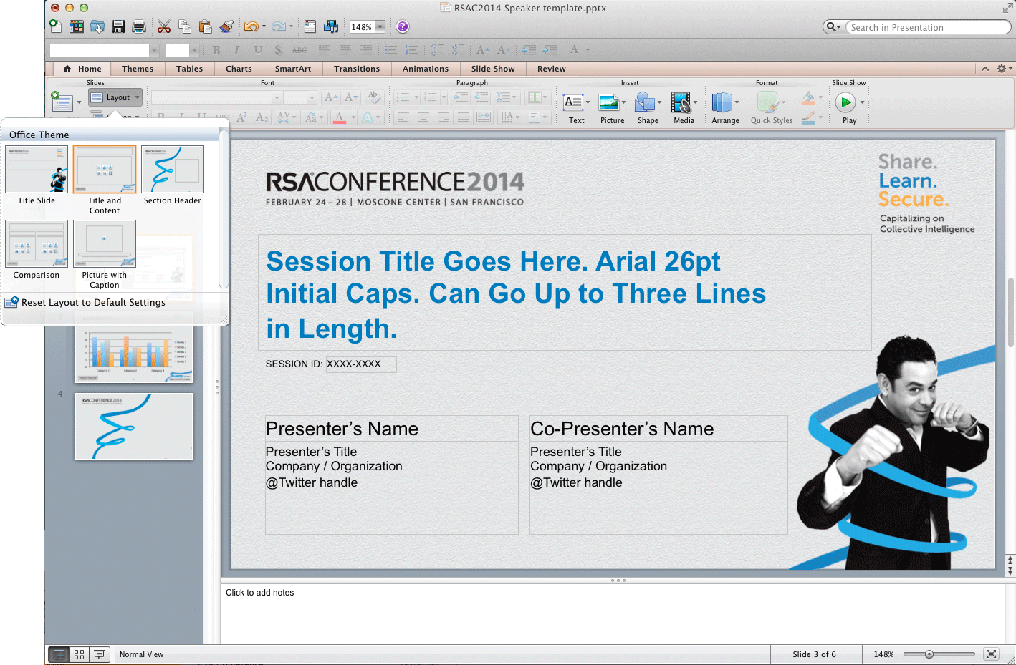
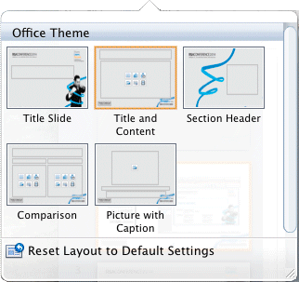
Using This Template
There are 5 pre-formatted slide layouts for you to use. These can be accessed in the LAYOUT window of the HOME ribbon

Slide 3
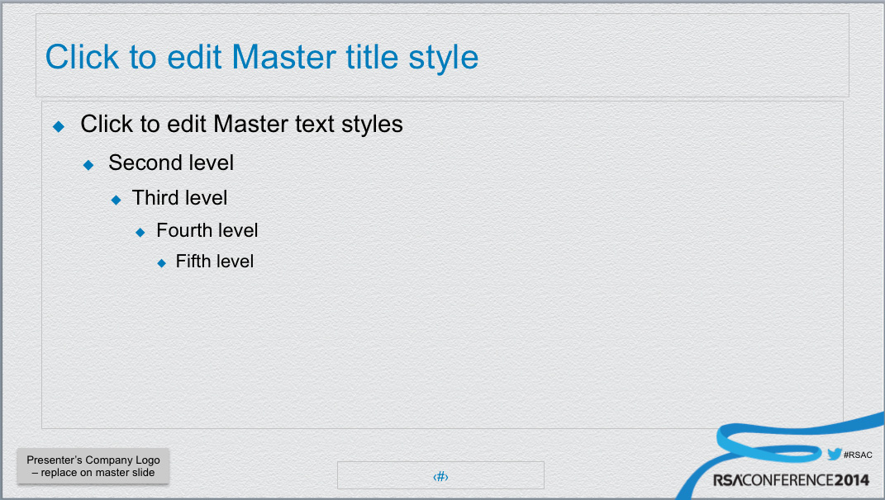
Using This Template
This template has been designed to allow you to insert your own logo in the lower left corner of the content slide.
To insert:
View > Slide Master
In the left-hand window, scroll to the top and click on the first template. (Important! Do not skip this step!)
Click on the placeholder box at lower left and delete
Insert > Picture and browse to your logo art
Resize logo art as needed
View > Normal

Slide 4
Chart colors default to the RSA Conference 2014 brand colors

Slide 6
Bullet text here
Second level talking point here
Third level talking point
Bullets can be indented by pressing the TAB key
Fifth level talking point, etc.

